Slide 1

VIBRATION MEASUREMENT SYSTEM USING ACCELEROMETER SENSOR
By
Shubhangi Kumari
(ECE083)
Rohit Raj
(ECE091)
School of Electronics and Communication Engineering
MIT World Peace University, Pune
School Mentor
Prof. R.D.KOMATI

Slide 2
Contents:
Project Title
Introduction
Literature Survey
Aim and Objectives
Project Description
(Block Diagram, Specifications, Explanation)
Project Implementation
Results
Tasks Completed till Date
Challenges And Solutions
Key Learnings till Date
Action Plan for the remaining term
Conclusion
References

Slide 3
Project Title:
VIBRATION MEASUREMENT SYSTEM USING ACCELEROMETER SENSOR.

Slide 4
Project Objective:
01 SENSE
02 PROCESS
To sense vibration conditions continuously.
To collect information of vibration.
.
03 ANALYS
04 DISPLAY
To analyze gathered data for better risk management.
Display the data over website and mobile application.

Slide 5
Literature Survey:
Maintenance of equipment means using a method to prevent equipment failure and keep them operational. Maintenance costs are a significant part of the total costs of operation for all factories and manufacturing plants. Maintenance costs can be from 15% to 60% [1] even 70% [2] depending on the industry of total costs. Maintenance management techniques can be classified into three key categories [3] that are as follows in order of efficiency [4]:
Run-to-Failure (R2F) or Corrective Maintenance - Maintenance procedures are carried out only after failures have occurred.
Preventive or Planned Maintenance (PvM) - Maintenance is performed based on time or process iterations according to a planned schedule.
Predictive Maintenance (PdM) - Maintenance is conducted based on an assessment of the health status of the equipment that comes from monitoring.

Slide 6
Introduction:
Existing technology mainly focus on controlling and monitoring of different activities. These are increasingly emerging to reach the human needs. An efficient monitoring system is required to monitor and assess the conditions in case of exceeding the prescribed level of parameters.
Sensors are placed at different locations to collect the data to predict the behavior of a particular area of interest. The system is supplied with a microcontroller for all sensor control.
In our system, the wireless standard has been chosen, which analyses the requirements of the application, so that the vibration conditions are constantly monitored and updated. There are many network standards for communication, but these are not just fully localized communication processes .
The most important thing here is the idea of connecting different electronic element, Sensors, and various devices via the Internet.

Slide 7
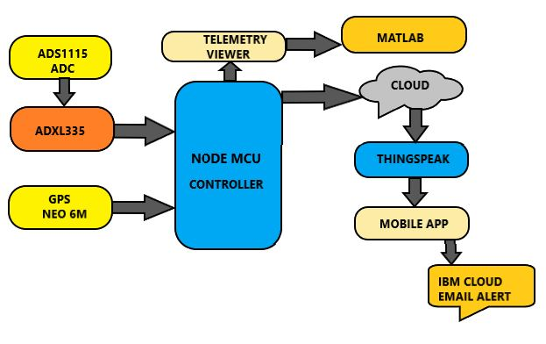
Project Description:
BLOCK DIAGRAM

Slide 8
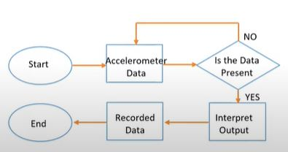
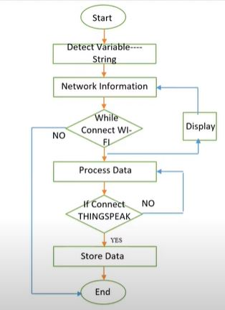
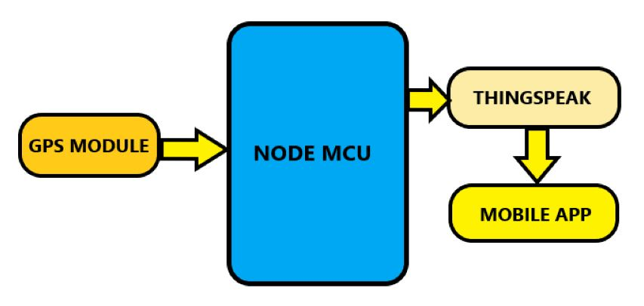
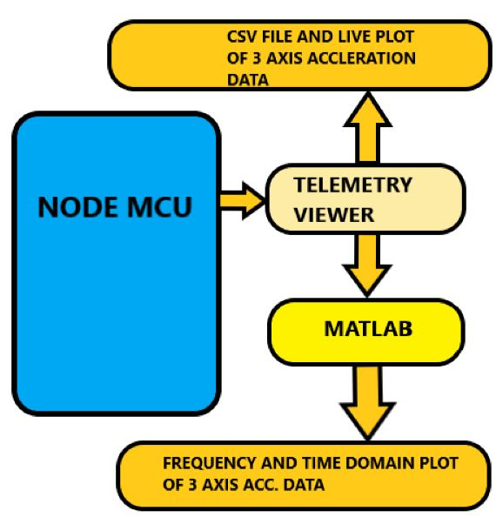
Project Description:
FLOW DIAGRAM:
Flow Chart of ADXL-335 data sensing operation.
Partial Block diagram for GPS MODULE data analysis process
Partial Block diagram for MATLAB and Telemetry viewer data analysis process
Flow chart for THINGSPEAK data analysis process.

Slide 9
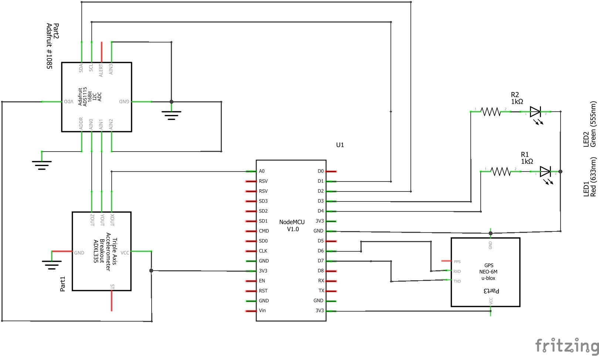
Project Description:
PIN TO PIN CIRCUIT DIAGRAM:
LED---NODE MCU
LED1(r)--- D4
LED2(g)--- D3
GPS---NODE MCU
RX--- D6
TX--- D7
ADS1115---ADXL335
A1N0--- Z_out
A1N1--- Y_out
ADS1115---NODE MCU
SCL--- D1
SDA--- D2
ADDR--- GND
ADXL335---NODE MCU
X_out--- A0

Slide 10
Methodology:
This IoT based project has four sections.
Firstly, Vibration sensors will measure and analyze the displacement, linear velocity, and acceleration and gps module will measure latitude and longitude.
Secondly, Node MCU it will be acting as bridge between virtual (Internet) and physical (Vibration) world by connecting it to the Internet where we could interpret the received data and work according to it.
Thirdly, the data received from accelerometer and gps we need to have a Web Application or App (Frontend) to monitor and for proper understanding. And for storing the data we are using THING SPEAK (Backend). Thing Speak server is an open data platform and API for the Internet of Things that enables to collect, store, analyze, visualize, and act on data from sensors.
Finally, For graphical representation such as velocity amplitude, acceleration etc. we will be using MATLAB and
TELEMETRY VIEWER.

Slide 11




Software/Hardware:
SOFTWARE:
Arduino Ide
Matlab
Telemetry viewer
Thingspeak
IBM Cloud
MIT App Inventor
HARDWARE:
Node Mcu
ADXL335
ADC1115
Gps Module
Led
Wire

Slide 12
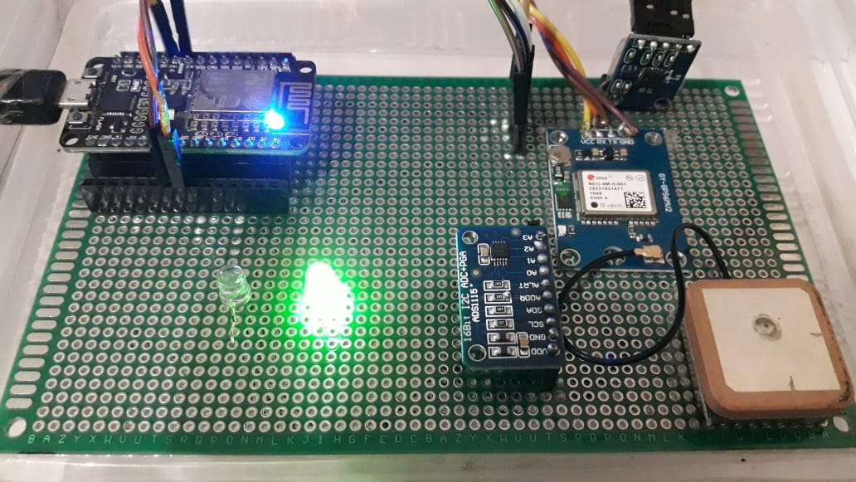
Result Screenshots:
ADXL335
NODE MCU
GPS MODULE
RED LED
GREEN LED
ADS1115

Slide 13
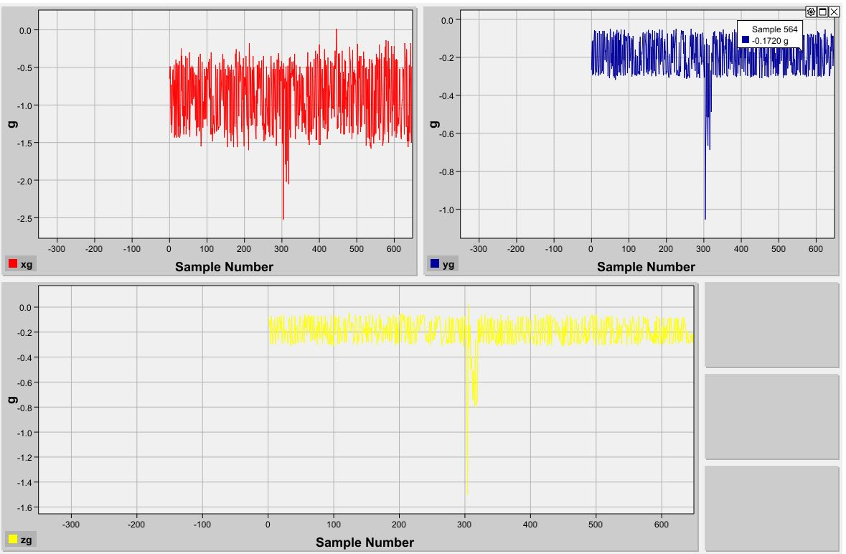
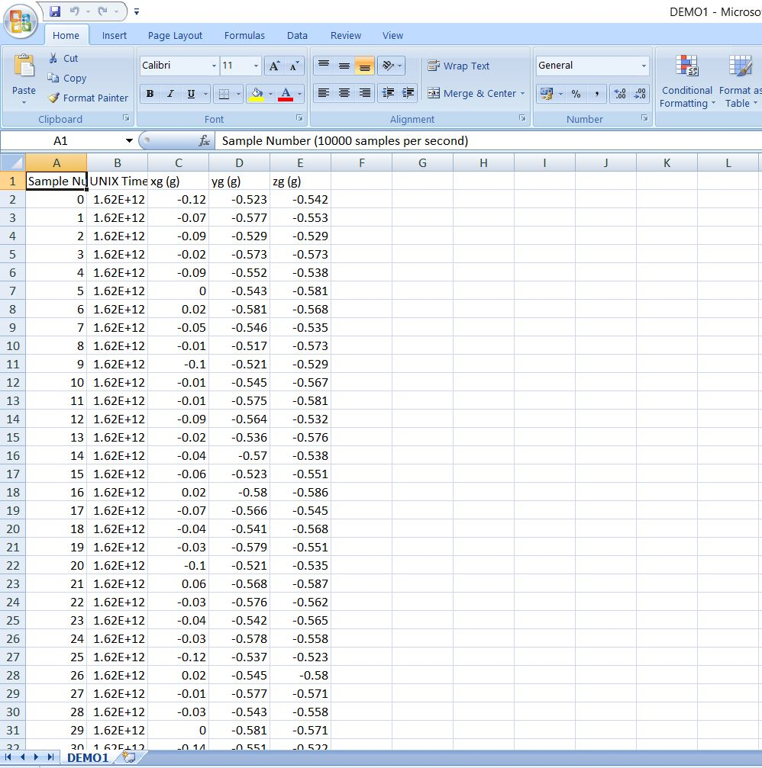
Result Screenshots:
Telemetry viewer live Plotting and csv data
X-AXIS
Y-AXIS
3-AXIS I.E X,Y & Z ACC DATA.
Z-AXIS

Slide 14
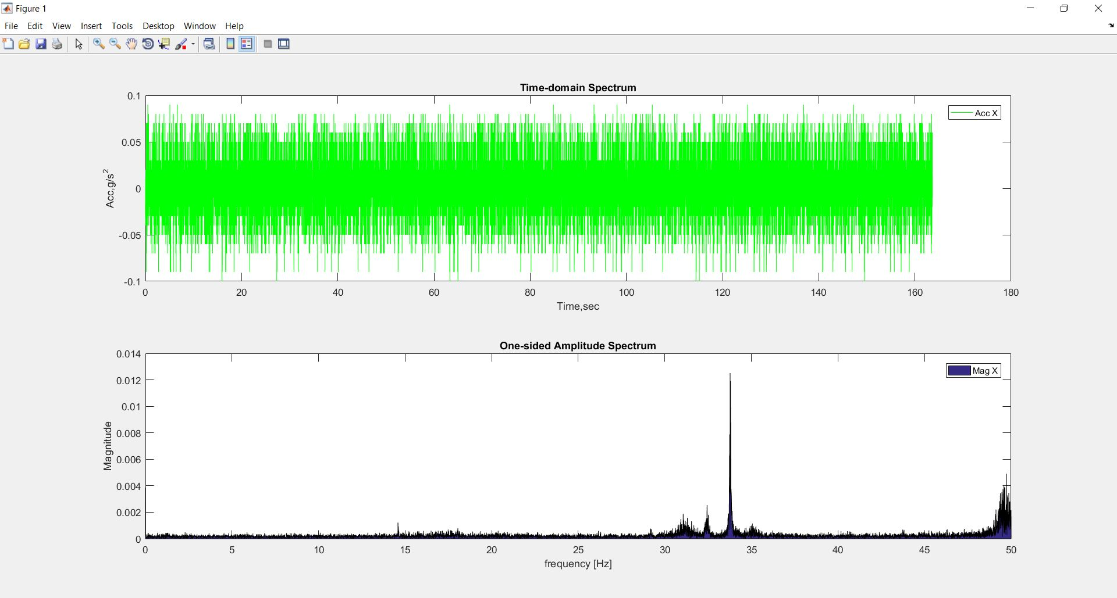
Result Screenshots:
MATLAB
32Hz

Slide 15
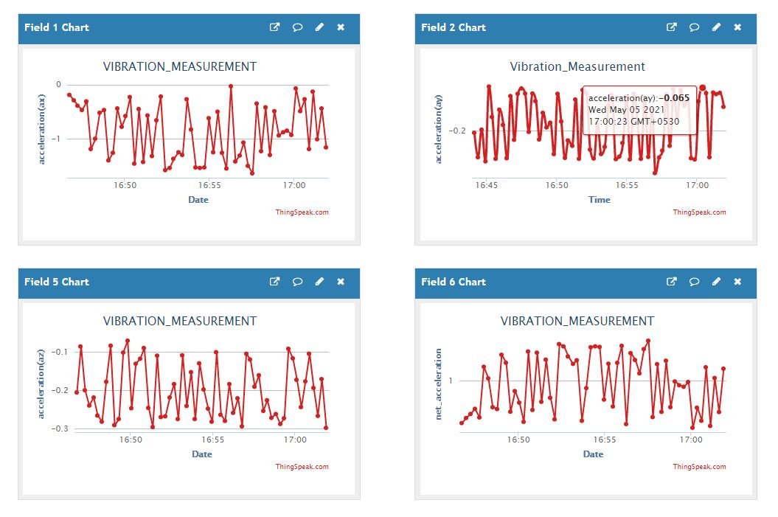
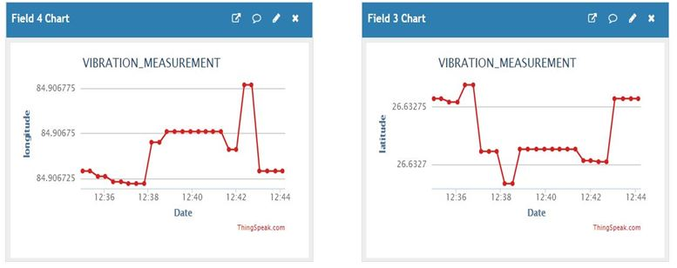
Result Screenshots:
Thigspeak Graph for 3-axis acc data and location data.
FIELD1:x-axis , FIELD2:y-axis , FIELD3:longitude , FIELD4:longitude , FIELD5:z-axis FIELD6:net_acc
LONGITUDE
LATITUDE

Slide 16
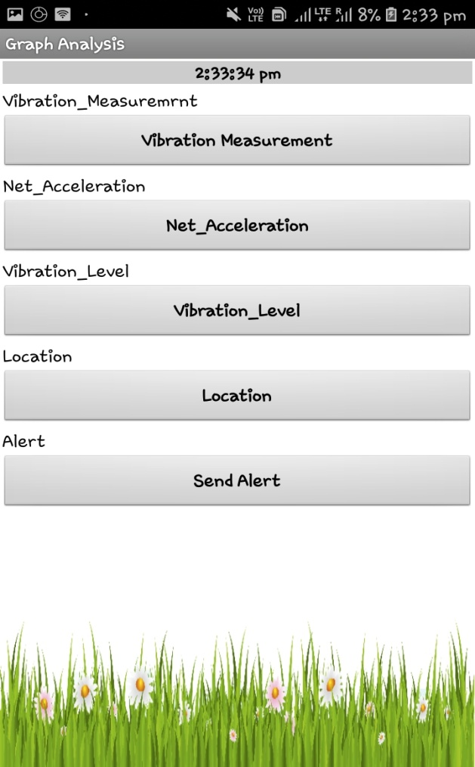
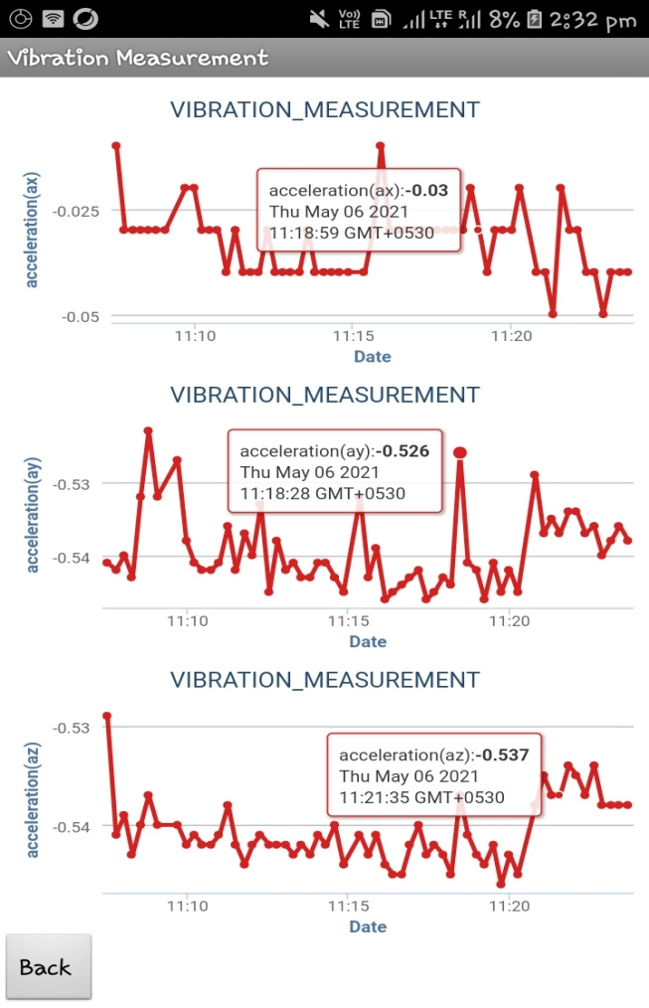
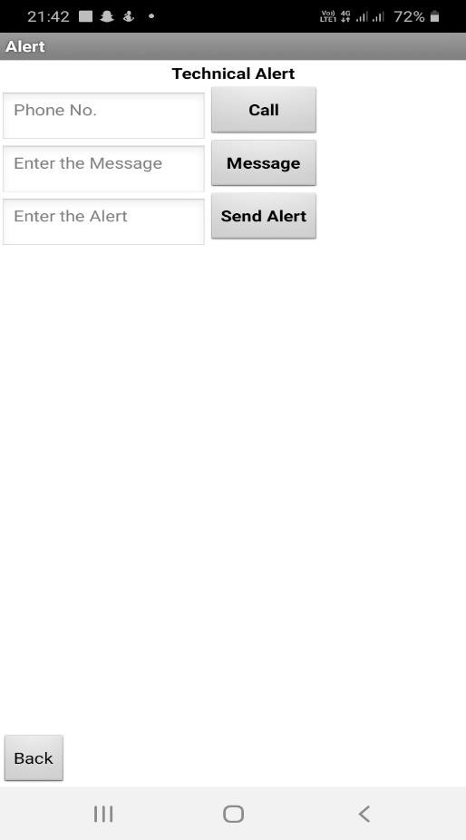
Result Screenshots:
Working of app:
HOME PAGE
DATA PAGE
ALERT PAGE

Slide 17
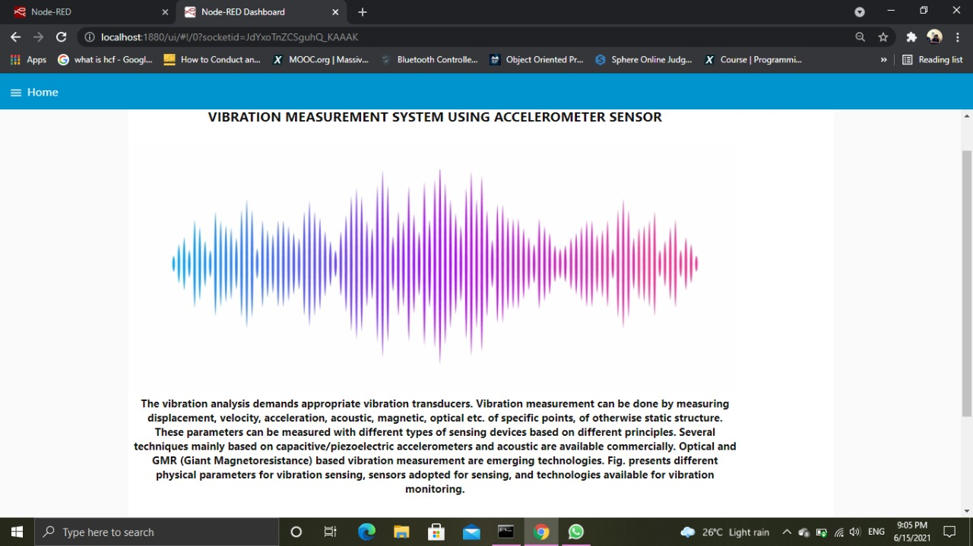
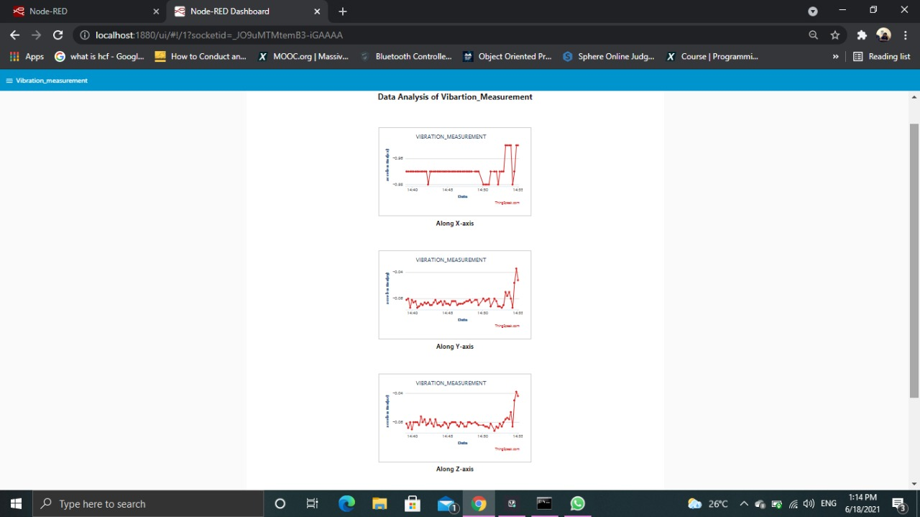
Result Screenshots:
Web Page Display
HOME PAGE
MAIN PAGE

Slide 18
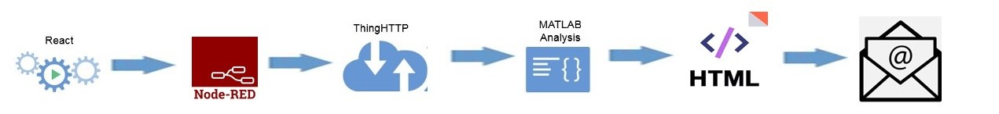
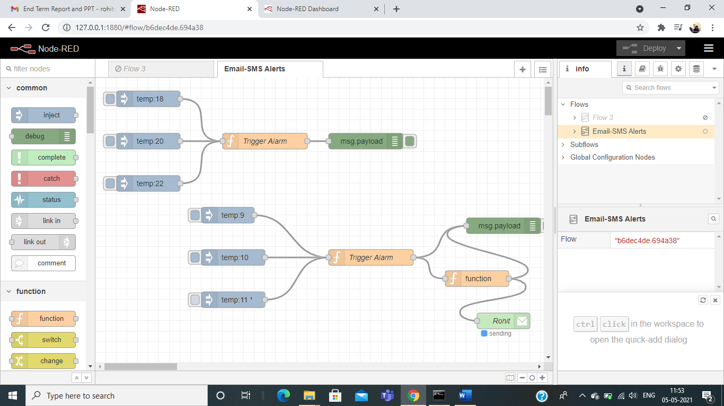
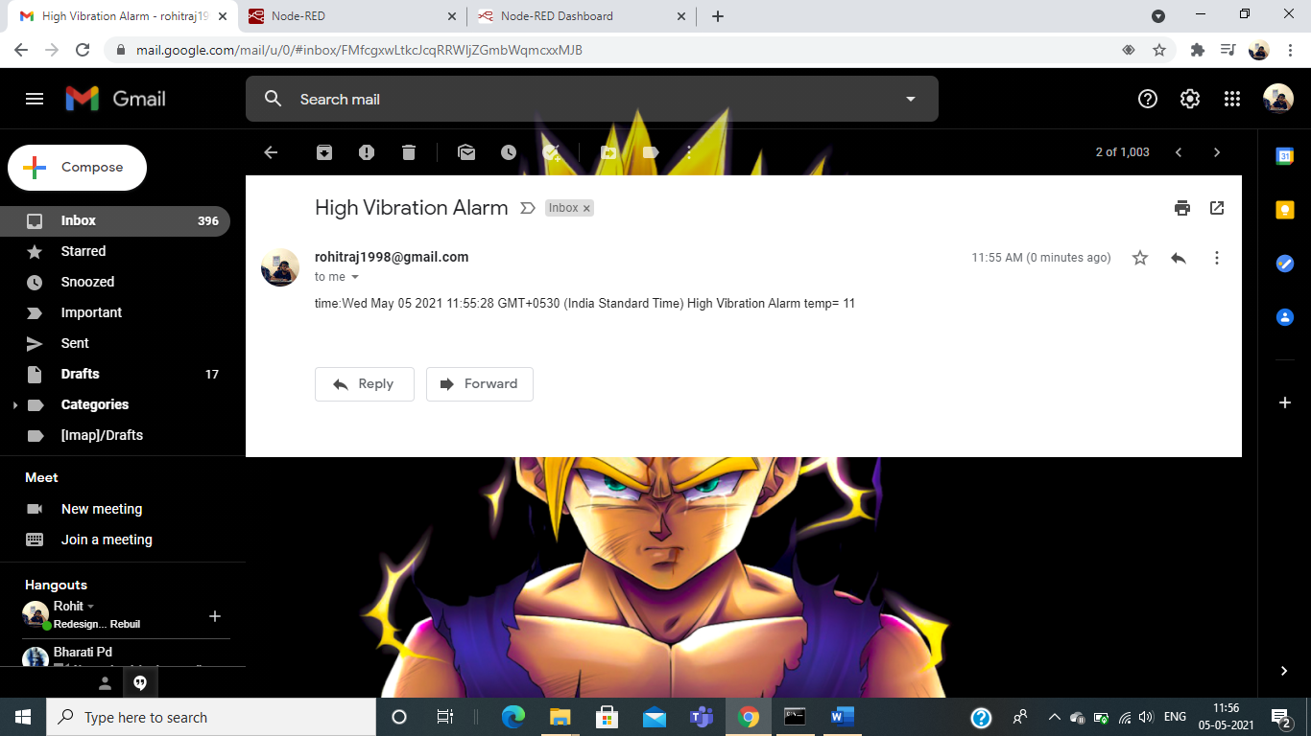
Result Screenshots:
DEPLOYMENT OF NODES IN NODE RED (IBM CLOUD)
EMAIL ALERT AND SMS USING NODE-RED USING IBM CLOUD FOR WEB APPLICATION
MAPPING
ALERT EMAIL

Slide 19
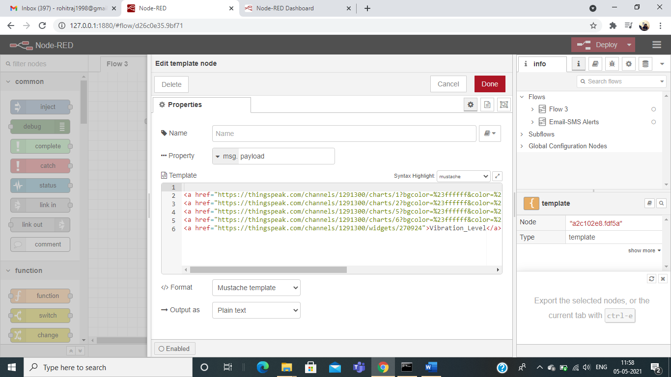
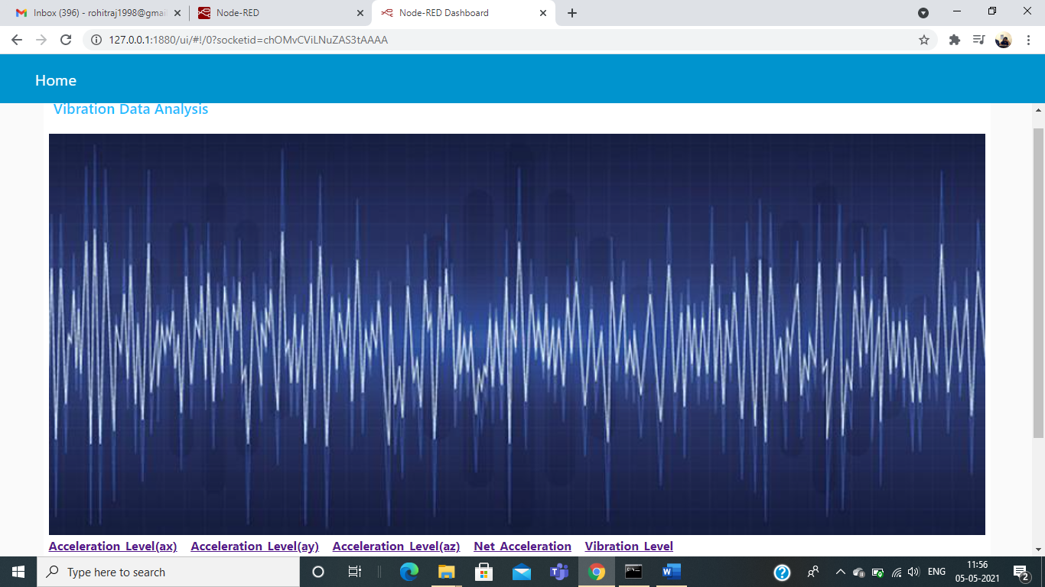
Result Screenshots:
IBM CLOUD DASHBOARD:
SYSTEM CONFIGURATION
GENERATED SIGNAL

Slide 20
Challenges And Solutions:
CHALLENGES:
Getting data from 3 axis as NODE MCU have only one analog pin.
storing data from com port to csv file.
Unable to get gps data.
Proper PCB board.
App development .
Not getting proper spike in fft matlab graph.
Telemetry viewer was slow when connected through internet.
Email sending system.
SOLUTIONS:
For getting data we used ADS1115.
Used open source software called telemetry .
Checked the power supply and moved the gps outdoor.
For PCB we used Zero board and soldered all
Components there.
For App development we watched various tutorials and courses and finally able to do our required development.
The data was not continuous ,stored in csv then used the data for plotting.
Prepared separate code for telemetry viewer without
internet required.
Used IBM cloud and red node for email
sending.
Challenges
And Solutions

Slide 21
Key Learnings Till Date:
Embedded system
About different sensors and its working.
controlling different sensors using microcontrollers.
IOT and MATLAB
Transmitting data from different sensors to web servers and cloud for further analysis and then plotting data using in different domain using matlab.
App development
App development to make access of information handy and accessible to all from any device and from any where across the globe .

Slide 22
Conclusion:
In final it can be said that this proposed model is beneficial for its proper acceleration vibration measurement and it is also a developed model for finding mechanical acceleration vibration which is much more efficient for safety purposes.
This is the basic idea of finding proper data by acceleration. it provides data with a minimum amount of error also provides some advanced facilities that other available devices cannot.
With wireless data transferring system it has ensured the safety purpose more strongly.
It is also cheaper than the available measuring devices in the market. With proper research, it can be updated more.

Slide 23
References:
[1] Mobley, Keith R..,(2002), An introduction to predictive maintenance. Elsevier.
[2] Dhillon, Balbir S., (2006), Maintainability, maintenance, and reliability for engineers. CRC press.
[3] Susto, Antonio Gian, Schirru Andrea, Pampuri Simone, McLoone Seán, and Beghi Alessandro Beghi. (2015), "Machine learning for predictive maintenance: A multiple classifier approach." IEEE Transactions on Industrial Informatics 11, no. 3:812-820.
[4] Susto, Antonio Gian, Beghi Alessandro, and Luca Cristina De., (2012), "A predictive maintenance system for epitaxy processes based on filtering and prediction techniques." IEEE Transactions on Semiconductor Manufacturing 25, no. 4:638-649.

Slide 24
Thank-You!!!

